Slide 1
Multivariate Autoregressive spectrogram modelling for noisy speech recognition
TA - Utkarsh Sir
20171174, Pentapati Sivani

Slide 2
What is Multivariate Autoregressive modelling?
There are three types of systems :-
All zero system => FIR System
All pole system => IIR System
Pole - Zero system => IIR System
The Moving Average model is a linear regression(linear dependency between dependent and independent variable) of current and previous observed noise terms. It is an FIR system.
The Autoregressive Model says that output depends linearly on its previous values and a imperfectly predictable term(in this case noise)and is an IIR System.

Slide 3
What is Multivariate Autoregressive modelling?
Autoregressive model is selected because the vocal tract that generates speech can be modelled as an all pole system in frequency domain with high rate of accuracy.
Reference :- All-pole model estimation of vocal tract on the frequency domain, INTERSPEECH 2006 - ICSLP, Ninth International Conference on Spoken Language Processing, Pittsburgh, PA, USA, September 17-21, 2006
Since we are having multiple frequency dependencies(taken from the filterbanks) we are calling it multivariate (multiple variable).

Slide 4
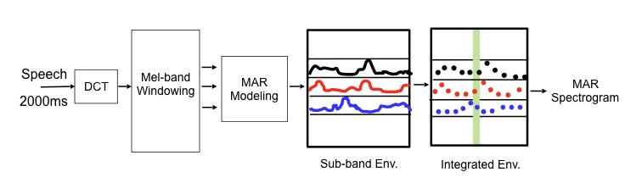
Block level understanding of the processing

Slide 5
Pre Processing of features
We will take a speech signal and then run frame-by-frame analysis iteratively.
A long speech signal is separated into 2000 ms non overlapping frames. The sampling frequency is 16 KHz which gives us a dimension of 1 X 32000 for frame.
We take DCT of the sequence.
We use a mel filterbank scheme with 39 overlapping sub-bands. Here, we use Gaussian overlapping windows centred at mel frequencies instead of normal triangular windows because gaussian curves have less error in fitting than triangular curves.
We estimate the Hilbert envelope of the signal from MAR modelling.

Slide 6
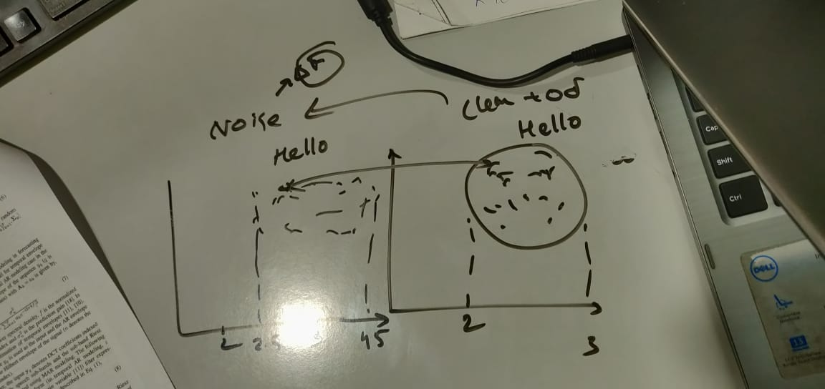
MAR Modelling the preprocessed features
In MAR model, we have tried to estimate the covariance of noise using method of generalised least square estimation.
Consider the following crude explanation.
If we have a clean spectrum of noise with some temporal bounds, then noised speech is just shifted version of the clean spectrum. To estimate the clean speech from noisy speech, we must estimate the distance between a point in the clean speech spectrum and its location in the noisy spectrum.
If in 3 dimensions(trivariate) we can project it onto a plane and estimate second norm. For multivariate we estimate all such projections using second norm distance(that is why least squares)

Slide 7
MAR Modelling the preprocessed features
We take the sub-bands obtained after mel-based gaussian filter bank and process them into the MAR model to derive the estimate Hilbert envelope(for 2D structure it is Riesz envelope) of the amplitude variations over time at a given frequency(from the filterbank)
At a time we take DCT coefficients of 3 mel bands jointly and use a model of order p = 160
Feature size is 39 X 276
We then integrate the envelopes using 25ms length, 10ms shift Hamming window.

Slide 8
Observations
MAR offers a smoother representation of spectrogram that emphasizes only the high energy regions of the signals.
We have used 39 inter-dependent frequency sub-bands which gives a joint estimation of the hilbert envelope. This helps us to focus on time-frequency correlations and suppress effects of noise.
This improves noise robustness in models that run on these features.
The output spectrogram is compared with conventional Mel spectrogram and the above observations are clear.

Slide 9
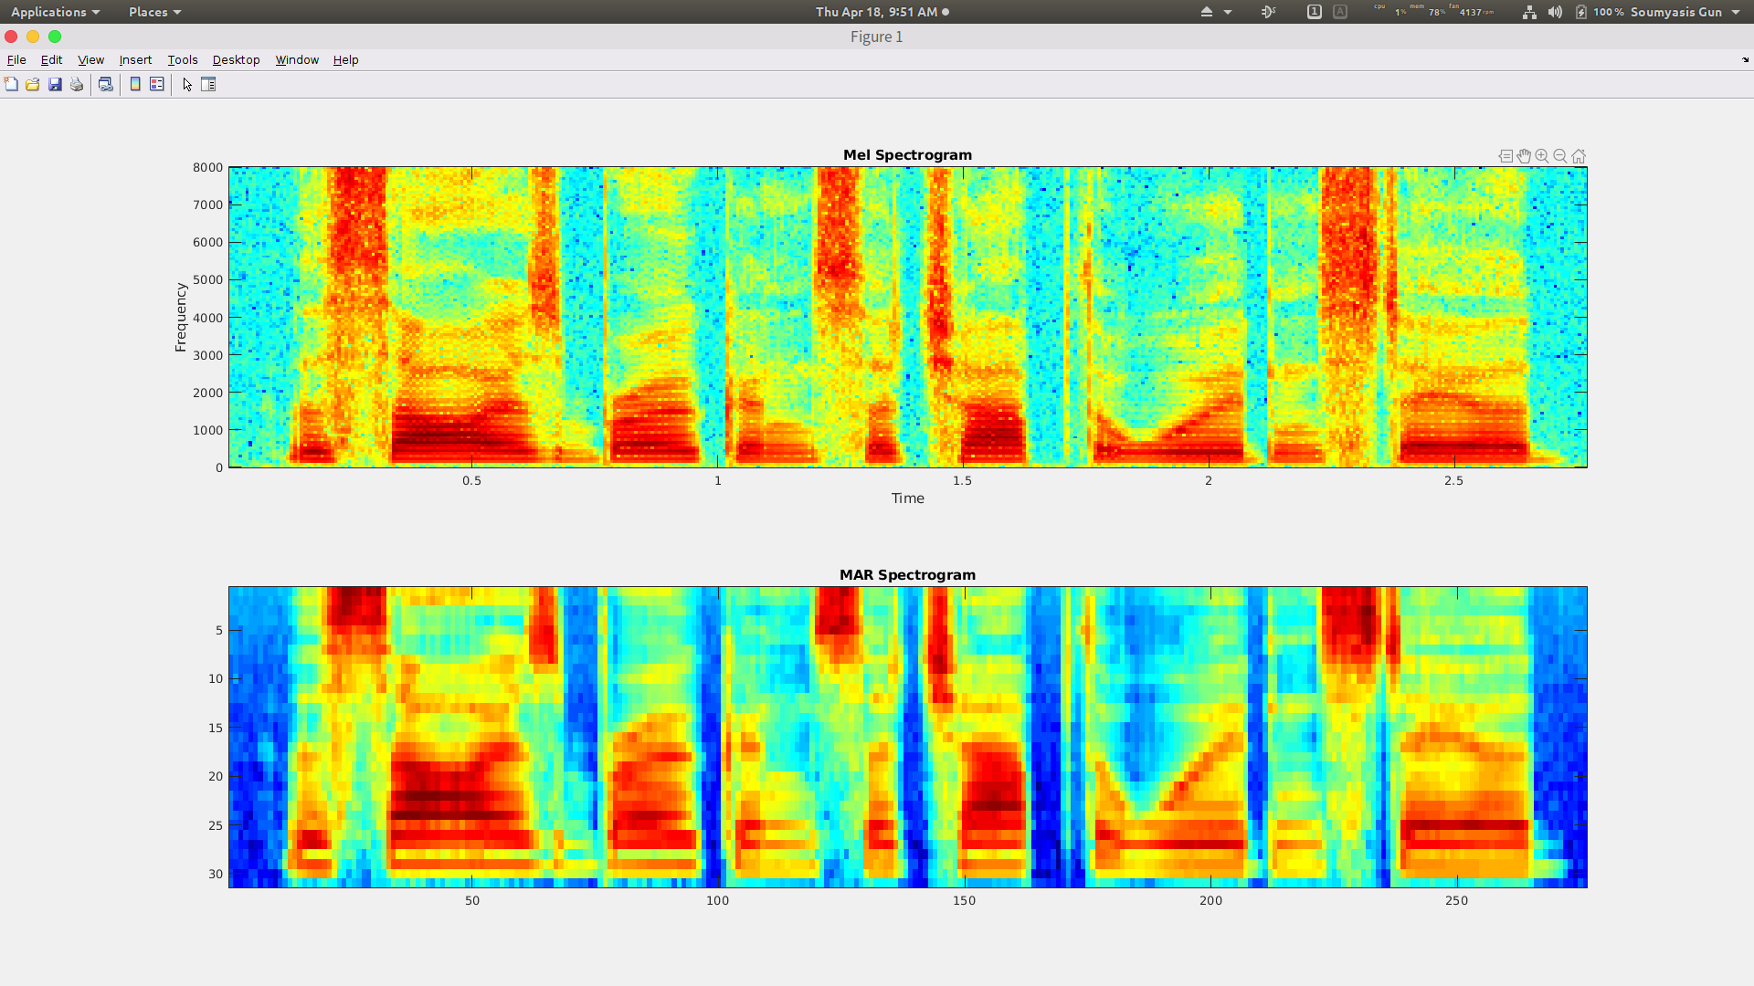
Comparison of MEl and MAR Spectrogram
Data used is a sample of British speech approximately 2 secs long.
Length is less to compare MAR spectrogram and Mel spectrogram

Slide 10
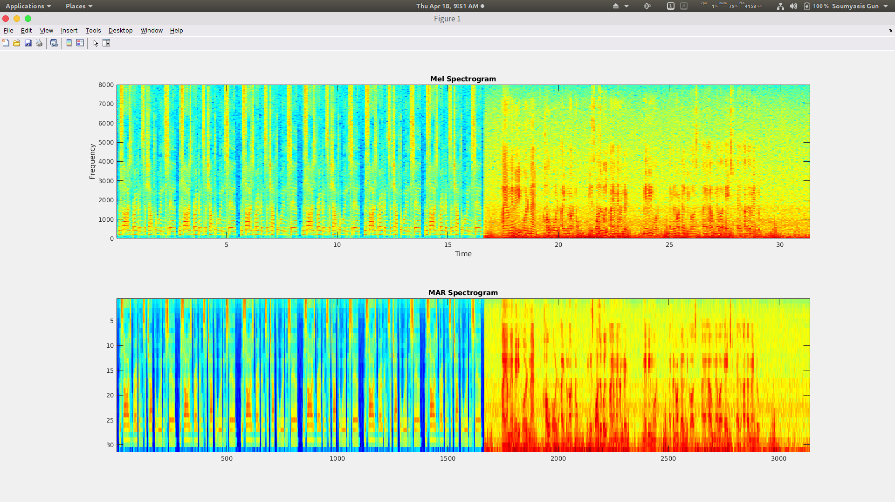
Comparison of MEl and MAR Spectrogram
Here the data used is an example of augmented data where multiple iterations of a recorded Indian speech and British speech is played.
Length of file is approximately 31 seconds

Slide 11
ASR(Automatic speech recognition) features
The integrated envelope so obtained by the overlapping windowing is made into a temporal resolution of 200ms. (centred around a 10 ms frame)
They are transformed to 14 DCT coefficients per sub-band.
The MAR features extracted are appended with spectral delta features.

Slide 12
Link to the work
Multivariate Autoregressive spectrogram modelling for noisy speech recognition

Slide 13
THank you

